Slide 1
CORE JAVA
Mr. Sachin Bhopi

Slide 2
Chapter 1
Introduction to JAVA
Fundamentals of JAVA
Operators in JAVA
Branching Statement in JAVA

Slide 3
Introduction to JAVA
History
Features of Java
JVM
Java Program Types
Java Platforms
Simple java Program
Implementation of java program

Slide 4

History
1991 James Gosling at Sun creates Java Language
Targeted at Consumer electronics - Cable top box, VCR, TV etc.
Goal was reliability not speed
1994 Hot Java Web Brower written (in Java)
Supports Applet – Downloadable programs that run inside web browser
Java Licensed by Netscape, Oracle, Microsoft and many others
Huge hype surrounding “Web Programming Language”
1997 Java 1.1 released with many standard libraries
Sun’s mantra becomes “Write Once Run Anywhere”
Enthusiastically supported by all major hardware and many software vendor
1998 Java 2 released, even more standard libraries
Now truly general purpose language

Slide 5
Features of Java

Slide 6
Features of Java
Simple
Syntax is based on C++ (so easier for programmers to learn it after C++)
Removed many confusing and/or rarely-used features
Operator overloading, Multiple Inheritance etc.
No Pointers
Automatic Garbage collection to unreferenced objects.

Slide 7
Features of Java
Object Oriented
Means that you focus on the data in your application and methods that manipulate that data, rather than thinking strictly in terms of procedures.
In an object-oriented system,
A class is a collection of data and methods that operate on that data.
The data and methods describe the state and behavior of an object.

Slide 8
Features of Java
Platform Independent
Java code can be run on multiple platforms
e.g. Windows, Linux, Sun Solaris, Mac/OS etc.
Java code is compiled by the compiler and converted into bytecode.
This bytecode is a platform-independent code because it can be run on multiple platforms i.e. Write Once and Run Anywhere(WORA).

Slide 9
Features of Java
Secured
No explicit pointer
Access restrictions are enforced.

Slide 10
Features of Java
Robust
Robust simply means strong
Lack of pointers avoids:
Security problem
Overriding Memory and Corrupt data
Automatic garbage collection to prevent memory leaks.
Exception handling and type checking mechanism in java.

Slide 11
Features of Java
Portable
We may carry the java bytecode to any platform.

Slide 12
Features of Java
Architecture Neutral
Compiler generates bytecodes, which have nothing to do with a particular computer architecture
Easy to interpret on any machine

Slide 13
Features of Java
High Performance
Java is an interpreted language, so it will never be as fast as a compiled language as C or C++.
In fact, it is about 20 times as slow as C. However, this speed is more than enough to run interactive, GUI and network-based applications, where the application is often idle, waiting for the user to do something, or waiting for data from the network.

Slide 14
Features of Java
Multithreaded
Java allows multiple concurrent threads of execution to be active at once.
This means that you could be listening to an audio clip while scrolling the page and in the background downloading an image.

Slide 15
Features of Java
Dynamic
It supports Dynamic memory allocation due to this memory wastage is reduce and improve performance of the application.
The process of allocating the memory space to the input of the program at a run-time is known as dynamic memory allocation.
To programming to allocate memory space by dynamically we use an operator called 'new' 'new' operator is known as dynamic memory allocation operator.

Slide 16
Features of Java
Interpreted
The Java compiler generates byte-codes, rather than native machine code.
To actually run a Java program, you use the Java interpreter to execute the compiled byte-codes.
Java Sample
The code is designed to transport programs efficiently to multiple platforms.
Rapid turn-around development
Software author is protected, since binary byte streams are downloaded and not the source code

Slide 17
Features of Java
Distributed
We can create distributed applications in java.
RMI and EJB are used for creating distributed applications. We may access files by calling the methods from any machine on the internet.

Slide 18
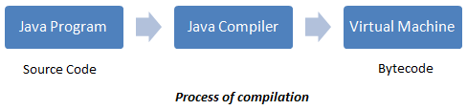
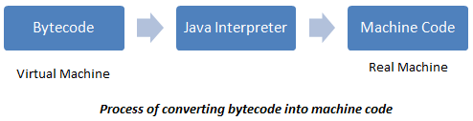
Java Virtual Machine (JVM)
Sample.java
javac Sample.java
Sample.class
java Sample

Slide 19
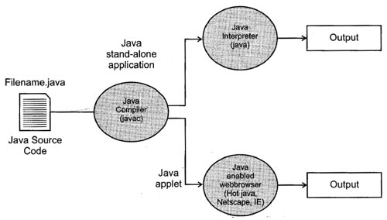
Java Program Types
Standalone Application
Web Applets

Slide 20
Java Platforms
Micro Edition (Java ME)
Standard Edition (Java SE)
Enterprise Edition (Java EE)

Slide 21
Simple Java Program
Program in C
Program in JAVA
void main()
{
printf(“Hello C”);
}
class Sample
{
public static void main(String args[])
{
System.out.println(“Hello Java”);
}
}

Slide 22
Simple Java Program
The first line is the class declaration
As stated earlier, Java is true Object Oriented Language and therefore everything must be placed inside the class. “Hello” is a java identifier that specifies the name of the class.

Slide 23
Simple Java Program
The second line is the main line declaration.
public static void main(String args[])
public:
The keyword “public” is an access specifier that declares the main method is unprotected. Hence it can be access by other classes.
static:
The main always declared as static because interpreter use this method before declaring the object.
void:
It states that main does not return any value.

Slide 24
Simple Java Program
main():
This is the starting point for the interpreter to begin the execution of the program.
String args[]:
It defines args parameter contain array of objects of the class type String.

Slide 25
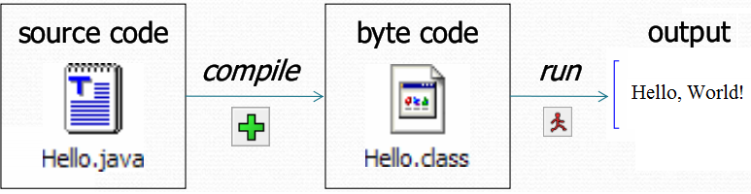
Implementation of Java Program
We can create the program using text editor.
Save this program in a file called Hello.java (filename and class name should be same)
To compile the program type line as shown below.
javac Hello.java
If every syntax is right then, javac creates a file called Hello.class contains the byte code.
Run the program on command line
java Hello
Now program executes and generates output as:
Hello, World!

Slide 26
Summary of Introduction to JAVA
History
Features of Java
JVM
Java Program Types
Java Platforms
Simple java Program
Implementation of java program

Slide 27
Fundamentals of JAVA
Character set
Comments
Identifier
Keywords
Constants
Variable
Datatype
Type conversation and Type casting

Slide 28
Character set
Java uses the Unicode (Universal Code) to represent the characters.
It currently supports more than 34,000 defined characters derived from 24 languages from America, Europe, Middle East, Africa and Asia (including India).
ASCII (American Standard Code for Information Interchange) which is a subset of Unicode Character Set.
Unicode full range: 65536 codes & ASCII full range: 256 codes.

Slide 29
Comments
Comments:
The comments are useful for documentation purpose.
Single line comment: //
Multiline comment: /* */

Slide 30
Identifier
Identifiers are the programmers design tokens or it is a name convention for class name, method name, variable name, interface and package in a program. Identifier must be meaningful, short enough to write and quickly read.
It has following rules:
It is a descriptive sequence of uppercase and lowercase letters and digits.
It should not begin with digit.
Uppercase and lowercase are distinct.
They can be of any length.

Slide 31
Identifier
All class and interface start with uppercase letter followed by lowercase letters. If name contains more than two words. Then each subsequent word leading with uppercase letter.
Example: Student, ComputerTechnology
All methods start with lowercase letters. If method contains more than two words then each subsequent word leading with uppercase letter.
Example: sum(), sumOfAll()
All variables use only lowercase letters. If variable contains more than two words then they must be combined with underscore between the words.
Example: radius1=5.5, balance=9999, marks_scored=100
Example: PI=3.14, INTEREST=12.5, TOTAL_MARKS=100

Slide 32
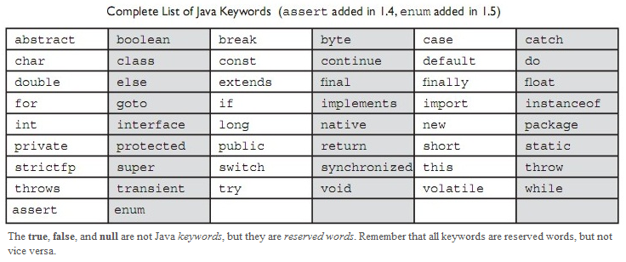
Keyword
Keywords are essential part of language definition. They implement specific feature of the language.
Since keywords have specific meaning in Java we cannot use them as names for variables, class, method etc.
All keywords are to be written in lower case.
Most of the keywords derived from C and C++

Slide 33
Constants in Java (Literals)
Constant is a programming element whose fixed value cannot be changed during the execution of the program.
Numeric Constants: includes Decimal constants, Octal Constants, Hexadecimal Constants and Floating Constants.
Non Numeric Constants: includes Character constants (which also includes escape sequence), String Constants, Boolean Constants.

Slide 34
Constants in Java (Literals)
Integer Constants:
Decimal integer consists of a set of digits between ‘0’ to’ 9’ proceeded by an optional sign. (i.e. -)
Example: 345, -67
Octal integer constant consists of any combination of digits between ‘0’ to ‘7’ with leading 0 (zero).
Example: 042, -076
Hexadecimal integer constant consists of any combination of digits between ‘0’ to ‘F’ with leading 0X.
Example: 0X28, 0x7A
For example, the value 43 may be represented by any of the following:
43 (Decimal) | 053 (Octal) | 0X2B (Hexadecimal)
0x2B (Hexadecimal) | 0X2b (Hexadecimal) | 0x2b (Hexadecimal)

Slide 35
Constants in Java (Literals)
Floating-point Constant: A Floating-point literal is represented by a floating-point number, and is used for both float and double data types.
Standard notation consists of whole number followed by decimal point and fractional digit.
Example: 12.34, -1.34
Scientific notations consist of floating point numbers plus (+) suffix that specifies power of 10 by which the number is to be multiplied. It is also called exponential notation.
Example: 1.25E+8.
The suffix f or F indicating a floating-point number such as 2.345f
The suffix d or D indicating a double number such as 26d
If the suffix f or d is not used, the literal is interpreted as of type double.

Slide 36
Constants in Java (Literals)
Character Constant: A literal character is represented inside pair of single quotes such as following:
Example:
char ch=’a’;
char ch=65; //integer literal representation of character A.
char ch=0102; //octal literal representation of character B.
char ch=0X43 //hexadecimal literal representation of character C.
Some characters used with backslash (\) give escape sequences in output.
\n → new line \t → tab i.e. 8 blank spaces
\f → form feed \r → carriage return

Slide 37
Constants in Java (Literals)
String Constant: String literals are the values of the String class objects. String literals are a collection of characters enclosed within double quotes.
Example: String msg=“Welcome to JAVA”;
Boolean Constants: A variable of Boolean type can have only one of two possible values, true or false. Therefore, these two values are the only available Boolean literals.
Example: boolean ans=true;
boolean ans=false;

Slide 38
Variable
The variable is the basic unit of storage location used to store the data value in Java program.
A variable defined by the combination of identifier type and an optional initialize.
All variable used have been declared before it is used in the program.
Variable may take different value at different time during the execution of the program.

Slide 39
Variable
Variable name may consist of alphabets, digits, underscore and also following condition:
They must not begin with digits.
Uppercase and lowercase are distinct.
It should not be a Keyword.
White spaces (Blank spaces) are not allowed.
You can initialize the variable by specifying an equal sign (=) and a value.

Slide 40
Variable
Instance variable: When the objects are instantiated instance variables are created and therefore they are associated with the object. They take different values each object.
Class variable: Class variables are global to a class and belong to the entire set of objects that same class creates.
Local variable: Variables declared used inside the method are called local variables However these variable to be declared within the block ({}).

Slide 41
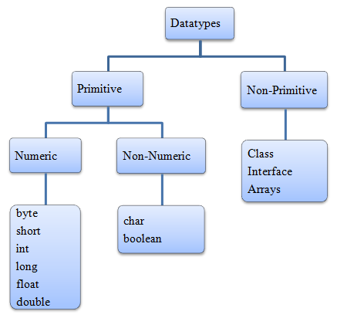
Data types
Every variable in java has a data type.
Data type specifies the size and type of values that can be stored.
Every variable, method,
expression has strict to
particular data type.

Slide 42
Data types
Data types:
There are eight primitive data types in Java
Name | Bits | Bytes | Range | Range of values
byte | 8 | 1 | 2⁻⁷ to 2⁷ | -128 to 127
short | 16 | 2 | 2⁻¹⁵ to 2¹⁵ | -32768 to 32767
int | 32 | 4 | 2⁻³¹ to 2³¹ | -2147483648 to 2147483647
long | 64 | 8 | 2⁻⁶³ to 2⁶³ | -9223372036854775808 to 9223372036854775807
float | 32 | 4 |  | ±1.4e-45 to ±3.4e+308
double | 64 | 8 |  | ±4.9e-324 to ±1.8e+308
char | 16 | 2 |  | Unicode (0-65535)
boolean | 1 |  | 0 to 1 | true or false

Slide 43
Type Conversion and Type Casting
Type Conversion: Type conversion is also known as Widening Conversion.
When one type of data is assigned to another type of variable, an automatic type conversion will take place if the following two conditions are satisfied:
The two types are compatible.
The destination type is larger than the source type.
The numeric types (integer and floating point types) are compatible with each other. The numeric types are not compatible with Boolean and classes.
Example: | byte b=65 int i=b*2
Output: | 130

Slide 44
Type Conversion and Type Casting
Type Casting: Type casting is also known as Narrowing Conversion.
If the destination type is smaller than source type then we should go for narrowing the conversion so that it will fit into target type.
Conversion from an int to a byte variable will not be performed automatically, because a byte is smaller than an int.
To create a narrowing conversion, we must use a cast. Casting into smaller type may result in a loss of data
General form: | (data type) variable_name
Example: | int i=130 byte b=(byte)i
Output: | -126

Slide 45
Summary of Fundamentals of JAVA
Character set
Comments
Identifier
Keywords
Constants
Variable
Datatypes
Type conversation and Type casting

Slide 46
Operators in JAVA
Arithmetic Operators
Relational Operators
Logical Operators
Bitwise Operators
Conditional Operators
Special Operators
Assignment Operators
Priority of Operators

Slide 47
Arithmetic Operators
Operator | Meaning
+ | Addition
- | Subtraction
* | Multiplication
/ | Division
% | Modulus
++ | Pre/Post Increment
-- | Pre/Post Decrement
+ | Unary Positive
- | Unary Negative

Slide 48
Arithmetic Operators
Increment:
Prefix: Here operators are preceded by the operand and the value is incremented before assigning.
Postfix: Here operator follows the operand and value is assigned first then operand is incremented by one.
Decrement:
Example: | int i = 5 int j = ++i | int i = 5 int j = i++
Output: | i=6, j=6 | i=6, j=5
Example: | int i = 5 int j = --i | int i = 5 int j = i--
Output: | i=4, j=4 | i=4, j=5

Slide 49
Relational Operators
Operator | Meaning
= = | is equal to
! = | is not equal to
> | is greater than
< | is less than
>= | is greater than equal to
<= | is less than equal to

Slide 50
Logical Operators
Operator | Meaning
& | Logical AND
| | Logical OR
^ | Logical EX-OR
! | Logical Not
&& | Short Circuit AND
|| | Short Circuit OR

Slide 51
Logical Operators
Example: | boolean helped_mom = helpMom(); boolean helped_dad = helpDad(); if (helped_mom || helped_dad) { playGames(); }
Explanation: | helpMom() and helpDad() methods checks whether you helped mom or dad and return the boolean value (i.e. true or false) which we store in boolean variables helped_mon and helped_dad which then evaluated using Short Circuit OR. Even if you helped either mom or dad you are allowed to play game i.e. playGames() method executes.

Slide 52
Bitwise Operators
Operator | Meaning
~ | Bitwise Not
& | Bitwise AND
| | Bitwise OR
^ | Bitwise EX-OR
>> | Shift Right
<< | Shift Left

Slide 53

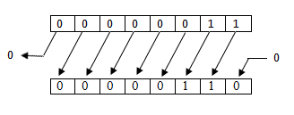
Bitwise Operators
Left Shift Operator (<<):
Right Shift Operator (>>):
Example: | byte i = 3; byte j=i<<1
Output: | j= 6
Example: | byte i = 6; byte j=i>>1
Output: | j= 3

Slide 54
Conditional Operators
The ternary operator [? :] used as conditional operator in Java language.
V= exp1 ? exp2 : exp3
Example: | a = 5 b = 10 x= (a>b) ? a : b | if (a>b) x=a; else x=b;
Output: | x=10 | x=10

Slide 55
Special Operators
Instanceof
Dot Operator
Example: | Student s= new Student(); s.sid=10; s.result(); String test = s instanceof Student ? “Right” : “Wrong”;
Output: | Right
Example: | Student s= new Student(); s.sid=10; // reference to instance variable sid s.result(); // reference to method result() String test = s instanceof Student ? “Right” : “Wrong”;

Slide 56
Assignment Operators
Variable Operator = Expression;
Example: a=10; b=20; | Simple Operator |  | Short hand |  | Output
 | a= | a+1 | a+= | 1 | 11
 | a= | a*4 | a*= | 4 | 40
 | a= | a%7 | a%= | 7 | 3
 | a= | a*(b+1) | a*= | (b+1) | 210

Slide 57
Priority of Operators
.

Slide 58
Summary of Operators in JAVA
Arithmetic Operators
Relational Operators
Logical Operators
Bitwise Operators
Conditional Operators
Special Operators
Assignment Operators
Priority of Operators

Slide 59
Branching Statements
Selection Statements/ Conditional Statements
Iteration Statements
Jump Statements

Slide 60
Chapter 2
Introducing Classes
Arrays, String and Vectors

Slide 61
Introducing Classes
Fundamentals of classes and Objects
Constructor
Method Overloading
Nested and Inner Class
Garbage Collection
Static Members
Access Control

Slide 62
Fundamentals of classes & Objects
Class is a template for an object; an object is an instance of a class.
Syntax: | Example:
class Name { type instance x; : : type instance y; type method one (parameter); type method two (); } | class Diploma { int a; int b; : Void add() { int x; x=a+b; } }
Instance Variables
Instance Method
Local Variable

Slide 63
Fundamentals of classes & Objects
Simple class
Class us user defined data type with the template that serves to define its properties.
Once a class type has been defined, we can create any number of objects belonging to that class. Remember, in class these variables only declared therefore no storage space has been created in the memory.
“A class name is declared by the use of “class” keyword.
The data variable defined within the class are called “instance variable”
The code is containing the function collectively called “methods”

Slide 64
Fundamentals of classes & Objects
Simple class
Example: A class “Box” defines three instance variable width, height and depth. In this case the class is define as
class Box { int width, height, depth; }

Slide 65
Fundamentals of classes & Objects
Declaring a object
Step 1: declare the variable of class type: The declaration of a variable does not define an object instead it simply refers to an object and it contains null value.
Step 2: Acquire a physical copy of an object: Allocates the actual objects and assign it to that variable using “new” operator. The “new” operator dynamically allocates the memory for an object.
Consider the following statement
Box b;
b = new Box();
The above two statement jointly written in following format
Box b = new Box ();
heightwidth length
NULL

Slide 66
Fundamentals of classes & Objects
Method declaration
Adding a Method with Parameter
Returning a Value

Slide 67
Constructor
Constructor looks bit stranger because it syntactically similar to method, but it do not contain any return type not even void.
A constructor initializes the object immediately after the creation.
By convention it represented by same name as class name in which it resides.
Box b = new Box();
There are two types of constructors
Default Constructor
Parameterized Constructor

Slide 68
Instance Variable Hiding
It is illegal in java to declare two variables with same name inside the same scope.
But when a local variable has a same name as that of the instance variable, the local variable hides the instance variable.

Slide 69
‘this’ keyword
‘this’ keyword can be used inside any method to reference current object, it always referring to an object by which method was invoked.
We can use ‘this’ keyword anywhere in the program reference to an object of current class.
To overcome the problem of variable hiding ‘this’ keyword is used.
It can be resolve any name collision that can occur between instance variable and local variable.

Slide 70
Method Overloading (Polymorphism)
In java, It is possible to define two or more methods within the class that shares the same name as long as their parameters declaration are different. This process is known as “Method Overloading”.
When an overloaded method invokes, java uses “type and/or argument” to determine which version of overloaded method to be called.
Java compiler will employ automatic type conversion only if no exact match is found.
Overloaded Constructor: In addition to overloading normal method, we can also overload constructor. When we overload a constructor, each version of that constructor can perform an activity we desired to construct.

Slide 71
Nested and Inner class
It is possible to define a class within another class such classes known as nested class. The scope of nested class is bounded by the scope of enclosing brackets ({}).
Example: If class ‘B’ is define within class ‘A’ then ‘B’ is known only to ‘A’ but not outside ‘A’
Inner class can access all variables and method of its outer class and may reference to them directly.

Slide 72
Garbage Collection
In Java when no reference to an object exist then that object is assume to be no longer needed and the memory occupied by the object can be released.
From where Garbage is collected:
The heap is that part of memory where Java objects live and it’s only part of memory involved in the garbage collection process.
When does the garbage collector run:
The garbage collector is under the control of the JVM therefore JVM decides when to run the garbage collector.
JVM typically runs the garbage collector when it senses that memory is running low.
Within your program you can ask the JVM to run the garbage collector using System.gc(), but there is no guarantee under any circumstances that the JVM will comply.

Slide 73
Garbage Collection
‘finalize()’ Method:
Java provides mechanism to run some code just before object is deleted by garbage collector that code is located in a method name ‘finalize()’.
As we know there is no guarantee when the garbage collector will run so we can’t predict when finalize() method will run therefore don’t put any essential code into your finalize() method.
protected void finalize() { Code…... ………… }
The keyword ‘protected’ is a specifier that prevents access to ‘finalize’ by code that define outside its class. This method is called just prior to garbage collection.

Slide 74
Static Members
Sometimes we want to define a member a member that is common to all the objects and accessed without using particular objects. Such members defined as follows;
static int i, j;
:
:
static add(x,y);
The members that are declaring as static are associated with class itself rather than individual objects.
The static variable and methods are often referred to as class variable and methods.
The static members can be called without using the objects.

Slide 75
Access Control
In some situation, it may be necessary to restrict the access of certain variables and methods outside the class. We can achieve this by applying visibility modifiers.
Modifier Location | Public | Default / Friendly | Protected | Private Protected | Private
Same Class | YES | YES | YES | YES | YES
Sub Class in same Package | YES | YES | YES | YES | NO
Other Classes in Same Package | YES | YES | YES | NO | NO
Sub Class in Other Package | YES | NO | YES | YES | NO
Non Sub Class in Other Package | YES | NO | NO | NO | NO

Slide 76
Summary of Introducing Classes
Fundamentals of classes and Objects
Constructor
Method Overloading
Nested and Inner Class
Garbage Collection
Static Members
Access Control

Slide 77
Arrays, Strings and Vectors
Array
String
StringBuffer
Vector
Wrapper Classes
Command Line Argument

Slide 78
Arrays
Array is a group of contiguous or related data items that share a common name.
Any specific elements in an array represent by the index.
Like any other variables, array must be declared and created in a computer memory before they are used.
Creation of array involves three steps.
Step 1: Declaration of array: Array in Java can be declared in two forms
Syntax | Example | Explanation
type arrayname[ ] | int num[ ] | ‘num’ is the name of the array which comprises int type elements.
type[ ] arrayname | float[ ] marks | ‘marks’ is the name of array which comprises float type elements.

Slide 79
Arrays
Step 2: Creating of Array: After declaring an array, we need to create it in the memory, Java allows us to create arrays using new operator only.
It is also possible to combine the two steps: declaration and creation
int num [ ] = new int [5]
Syntax: | Arrayname = new type[size]
Example: | num = new int[5]
Explanation: | In above example the array name ‘num’ refers to 5 integer type elements.

Slide 80
Arrays
Step 3: Enter the values into an array: The final step is to put the values into the array created. This process is knows as initialization. This is done using subscripts as shown below.
We can also initialize the array automatically in the same way as the ordinary variable declared.
For example: int num[ ] = {10,20,30,40,50};
Two Dimensional array
For Example: int mat = new int [3][3]
Syntax: | Arrayname [subscript] = value
Example: | num[0] = 16, num[1] = 46 …..

Slide 81
String
Normally string is a sequence of character but in Java, String is a class.
String objects are immutable i.e. Once the String object is created you cannot change the character comprising on it.
However we can still perform all type of string operation by creating new String object that contain modification.

Slide 82
String
SOME MOST COMMONLY USED STRING METHODS
Method Call | Task Performed
s2 = s1.toLowerCase; | Converts the string s1 to all lowercase
s2 = s1.toUpperCase; | Converts the string s1 to all Uppercase
s2 = s1.replace(‘x’,’y’); | Replace all appearances of x with y
s2 = s1.trim(); | Replace white spaces at the beginning and end of the string s1
s1.equals(s2); | Returns ‘true’ if s1 is equal to s2
s1.equalsIgnoreCase(s2); | Returns ‘true’ if s1 equals s2, ignoring the case of characters.
s1.length(); | Gives the length of s1
s1.charAt(n); | Gives n^{th} character of s1
s1.compareTo(s2); | Return –ve if s1<s2, +ve if s1>s2, and 0 if s1 equals s2
s1.concat(s2); | Concatenates s1 and s2
s1.substring(n); | Gives substring starting from n^{th} character
s1.substring(n,m); | Gives substring starting from n^{th} character up to m^{th}
s1.indexOf(‘x’); | Gives the position of first occurrence of ‘x’ in the string s1
s1.indexOf(‘x’,n); | Gives the position of ‘x’ that occurs after nth position in the string s1
String.valueOf(p); | Creates a string object of the parameter p.
p.toString(); | Creates a string representation of the object p.

Slide 83
Vectors
Vector implements a dynamic array that can hold object of any type and any number.
Vector class is contained in the java.util package.
Vectors can posses number of advantages over Arrays
It is convenient use vectors to store objects.
A Vector can be used to store a list of objects that may vary in size.
We can add and delete objects from the list.
A major constraint for using Vectors is that we cannot directly store simple data types in a vector. Therefore we need to converts these data type into objects using wrapper classes.

Slide 84
Vectors
Vectors are created as follows:
Syntax: | Vector name = name Vector()
Example: | Vector Diploma = new Diploma(3)
Explanation: | In Java, default Vector has initial size of 10. All the Vectors start with initial capacity. After initial capacity is reached, the Vector automatically allocates the space for additional objects. The amount of extra space allocated for each object should be specified at the time of creation of constructor [Vector(int size, int incr)]]. If you don’t specify an increment, the vector’s size is doubled by each allocation cycle.

Slide 85
Wrapper Classes
Java uses simple data types such as int, float and char for storing the values.
These data types are not part of the object hierarchy.
They are passed by the value to the method and cannot directly pass as a reference.
The Vector cannot handle the primitive data type.
For this purpose primitive data types converted into object type to store and manipulate in vectors. This conversion is done by Wrapper class methods.
Contained in a java.lang package.

Slide 86
Wrapper Classes
LIST OF PRIMITIVE DATA TYPES AND THEIR WRAPPER CLASSES
Primitive Data Types | Wrapper Classes | Constructor Argument
char | Character | char
boolean | Boolean | boolean or String
byte | Byte | byte or String
short | Short | short ot String
int | Integer | int or String
long | Long | long or String
float | Float | float or String
double | Double | double or String

Slide 87
Command Line Arguments
We can write java program that can receive and use the arguments provided in the command line.
The Java program stores the command line argument in the array of string which is passes to main() method in the program and store it in the args[].

Slide 88
Chapter 3
Inheritance
Packages

Slide 89
Inheritance
Single Inheritance
‘super’ Keyword
Multilevel Inheritance
Method Overriding
‘final’ Keyword
Abstract methods and classes
Interface
Multiple Inheritance
Dynamic Dispatch Method

Slide 90
Inheritance
Inheritance is one of the corner stone of OOP. It gives the aspects of reusability in which classes are used in several ways. This is basically done by creating a new class and reusing the property of existing one. The mechanism of deriving a new class from old one is called inheritance. The process of inheritance does not affect the base class.
Syntax:
class Subclass extends Superclass { Variable declaration; Method declaration; }

Slide 91


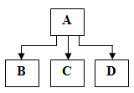
Inheritance
Forms of Inheritance in Java
Single Inheritance | Only one Super class and one Sub class
Multilevel Inheritance | Sub class is created by sub class of super class
Hierarchical Inheritance | One super class and multiple sub class
NOTE : Java does not directly implement multiple inheritance. It is done by interface technique.

Slide 92
‘super’ Keyword
Encapsulation is main concept of OOP. Sometimes we want to create a super class that keeps the details of its implementation to itself then there would be a no way for a sub class to directly access these variables on its own. But Java provides solution to this problem using the keyword “super”.
This keyword has two general forms:
1st form → Call super class constructor
2nd form → Use to access the members

Slide 93
Method Overriding
Method overriding also known as Dynamic Polymorphism or runtime polymorphism.
In a class hierarchy, When a method in a sub class has same name and type as method in a super class then method in a sub class is set to be overriding the method in super class.
When an overriding method is called within sub classes it will be always refer to the method define by the sub class and method in super class will be hidden.
Rules for Method Overriding:
Rule 1: The method signature must be same.
Rule 2: We cannot override a static method to make it non static
Rule 3: We cannot override private methods
Rule 4: We cannot override final method.
Method Overloading Vs Method Overriding

Slide 94
‘final’ keyword
final class: Sometime we want to prevent a class from being inherited. To do this, precede the class declaration with ‘final’ keyword. Declaring a class as ‘final’ implicitly declares all of its methods are final.
final method: When we want to prevent method overriding specify final as modifier at start of its declaration. Method declaration as ‘final’ cannot be overridden.
final variable: Sometimes we want variable value to be constant throughout the program. To do this, precede the variable datatype with ‘final’ keyword.
Example: final float PI=3.14f;

Slide 95
Abstract method and classes:
Abstract classes are classes from which instances are usually not created. It is basically used to contain common characteristics of its derived class.
Abstract classes are generally higher up in the hierarchy and acts as super classes.
Methods can also be declare as abstract. Implementation of abstract methods absolutely essential, thus making overriding compulsory.
We cannot declare abstract constructor or abstract static method.
This concept done using the modifier keyword called ‘abstract’.
Syntax:
abstract class Rect { abstract void area(); : }

Slide 96
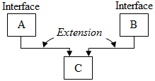
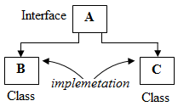
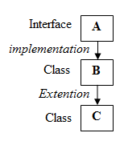
Interface
There are situations in which you may want to define a super class that defines generalized form that will be shared by its sub classes and also leave it to each sub class to fill the details. In this situation, java uses interface technique.
An Interface is basically kind of class, like classes interface contains variables and methods but with functional difference.
The difference is that interface defines only abstract methods and final data variable.
That is interface do not specify any code to implement this methods and data field contain only constant.

Slide 97
Interface
Defining an interface: The general form of interface is
interface name { Variable declaration; Method declaration; }
Here ‘interface’ is the keyword and ‘name’ is any valid Java identifier. In an interface, all variables are declared as constant it means that they cannot change by implementing class. Variable are declared as follows: static final type variable = value; The methods are declared with no body, they are usually called as abstract methods. Methods are declared as follows: return_type method_name(parameter list);
Implementation an interface: Interface are used as super class whose properties are inherited by subclass. It is necessary to create a sub class that inherits the given interface
Syntax 1: class class_name implements interface_name { ……. Body of class } Syntax 2 : class class_name extends super_class implements interface1, interface2,… { ……. Body of class }

Slide 98
Multiple Inheritance
The advantage of inheritance is that it enables Multiple Inheritance as it is possible for a class to implement more than one interface.
In multiple inheritance; subclass is derived from multiple super classes.
For Example

Slide 99
Abstract Classes Vs Interfaces
Parameters | Abstract Classes | Interfaces
Variable | Abstract class can contain instance variables also. | Interface cannot contain instance variables. It contains only constants.
Methods | Abstract class can contain some abstract methods and some concrete methods. | Interface can contain only abstract methods.
Implementation | All the abstract methods of the abstract class should be implemented in its sub classes. | All the abstract methods of the interface should be implemented in its implemented classes.
Constructors | Abstract classes can have constructors and those constructors are always called when concrete subclass is instantiated. | Interface do not have constructor.
Changes | If a new method is added to an abstract class, then there is an option of providing implementation and therefore all existing code works without any change. | If a new method is added to an interface, then it is required to track down all the implementations of the interface and define it.
Usefulness | Abstract classes are useful in situation when some general methods should be implemented and specialization behavior should be implemented by the subclasses. | Interfaces are useful in a situation when all its methods need to be implemented by subclasses.

Slide 100
Packages
Java API Packages
Importing Package
Creating and Importing User Defined Package

Slide 101
Java API Packages
JAVA
lang
util
io
awt
net
applet
Different API Packages
java.lang | These classes are that java compiler itself uses and therefore they are automatically imported. They include classes for primitive types, String, threads etc.
java.util | This package contains vector table, hash table, date, etc.
java.io | They provide the facilities for input and output of data and files.
java.awt | Set of classes for implementing graphical user interface. They include classes for windows, button, lists, menus and so on.
java.net | They include classes for communicating local computer with Internet server.
java.applet | Implementing and perform manipulation with an applet.

Slide 102
Importing Package
There are two ways to accessing a class stored in a package:
The first approach is to use fully qualified class name. This is done by writing a package name and class name separated by dot operator and preceded by import keyword.
Syntax 1: import package_name.class_name; import java.awt.Color; import java.util.Scanner;
In many situations, we may like to use more number of classes contained in a single package then we have to use ‘*’ after the package name which will bring all classes of particular package.
Syntax 2 : import package_name.*; import java.awt.*; import java.util.*;
Program On User Defined Package

Slide 103
Chapter 4
Exception Handling
Multithreading

Slide 104
Exception Handling
Exception & Exception Handling
Java Exception Handling

Slide 105
Exception & Exception Handling
“An Exception is the condition that is caused by run time error in the program. If it occurred java interpreter creates an exception object and throws it.”
Exception handling is a process of handling the Exception object by using try-catch-finally block to prevent the program from abnormal termination and continue with the remaining code.
There are two types of Exceptions:
Checked Exceptions:
The exceptions that are checked at compilation time by Java compiler are called Checked Exceptions.
Unchecked Exceptions:
The exceptions that are checked by the JVM are called Unchecked Exceptions.

Slide 106
Java Exception Handling
Java exception handling is managed via five keywords:
Keywords | Meaning
try | Program statements that you want to monitor for exceptions are contained within a try block. If an exception occurs within the try block, it is thrown.
catch | Your code can catch the exception thrown by try block and handle the exception.
throw | System generated exceptions are automatically thrown by Java run-time system. To manually throw an exception, use the keyword throw.
throws | Any exception that is thrown out of method must be specified by throws clause.
finally | Any code that must be executed before a method returns is put in a finally block.

Slide 107
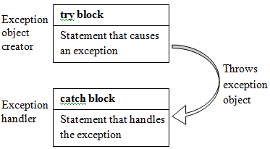
Java Exception Handling
Try and catch keyword
A block of codes that are likely to cause an error condition and throw an exception should be enclosed ‘try’ block. An exception thrown by ‘try’ block should be caught and this statement enclosed under catch block.
Syntax:
try { Statement 1; Statement 2; Statement3; } catch(Exception e) { Statement X; } Statement Y;

Slide 108
Java Exception Handling
Nested try-catch block
When a try catch block is a part of another try catch block, then such a block is called nested try-catch block.
Multiple catch blocks
There can be cases in which more than one exception could be raised by a single piece of code. To handle this type of situation, we can specify two or more catch clauses, each catching a different type of exception.
‘finally’ keyword
When exceptions are thrown, execution in method takes non-linear path that alters the normal flow through the method. The finally block will execute whether or not an exception is thrown. The finally clause can be useful for closing file handles and freeing up any other non java resources.

Slide 109
Java Exception Handling
‘throw’ keyword
Sometimes we would like to throw our own exception. It is possible explicitly using throw statement.
‘throws’ keyword
Throws clause list all types of Exceptions that a method might throws. If a method is capable of causing an exception that it does not handle, then it must be specified the behavior, so that caller of method can guard themselves against that exception.

Slide 110
Multithreading
Thread
Extending & Implementing Thread
Thread Life Cycle
Thread Priority
Thread Synchrolization

Slide 111
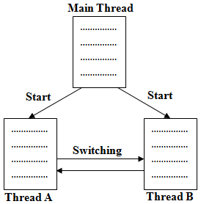
Thread
In multithreading, the thread is a smallest unit of dispatchable code or light weight process.
Since Thread in java are subprograms of a main application program and share the same memory space.
Multithreading is a conceptual program technique where a process is divided into two or more sub process, which can be implemented at same time in parallel.

Slide 112
Extending & Implementing Thread
Java Thread Model:
Creating a new Thread: Java is multithreading system, it is built upon thread class and its companion interface called Runnable.
A new thread cab be created in two ways.
By creating a thread class, i.e. defined a class that extends thread
Syntax: class ClassName extends Thread
By converting a class in to a thread that implements Runnable Interface.
Syntax: class ClassName implements Runnable

Slide 113
Extending & Implementing Thread
Extending Thread Class:
It include following Steps
Declare class as extending thread class
Implement run method that thread will execute
Create thread object in main program OR Pass an object that extends Thread class as a parameter to the constructor of an object type Thread.
Call start() method using thread reference.

Slide 114
Extending & Implementing Thread
Implementing Runnable Interface
It include following Steps
Declare class as implementing Runnable interface
Implement run() method that thread will execute
Create Thread object.
Pass an object that implements the Runnable interface as a parameter to the constructor of an object of type Thread.
Call start() method using thread reference.

Slide 115
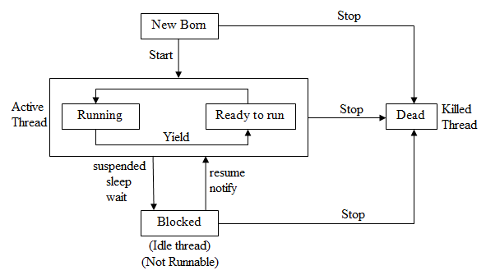
Thread Life Cycle
Thread may be in one of the five states:
New State
Runnable State
Running State
Blocked State (Waiting / sleeping)
Terminated / Dead State

Slide 116
Thread Priorities
Priorities are used by thread scheduler to decide when each thread allowed to be allowed run. In java, each thread automatically gets equal priority (By default=5). Therefore they share the processor on FCFS basis. But practically higher priority threads are executed first.
To set the priority, we make use of setPriority() method.
Syntax: Threadname.setPriority(int number);
‘number’ specify the new priority settings, the Thread class defines following constant
Thread.setPriority(Thread.MIN_PRIORITY)=1
Thread.setPriority(Thread.NORM_PRIORITY)=5
Thread.setPriority(Thread.MAX_PRIORITY)=10

Slide 117
Thread Synchronization
If two or more threads need to access a shared resource, they need some way to ensure that the resource will be used by only single thread at a time. The process by which is achieved is called Synchronization.
Synchronization based on the concept of ‘monitor’. A monitor is an object that is used as a mutually exclusive lock “mutex”. Only single thread can own the monitor at a time. When thread gets holds of the lock, it is said to have entered the ‘monitor’ All other threads attempts to entering the locked monitor will be suspended until the first thread exists the monitor.
In java, the keyword “Synchronized” helps to solve such problems, When we declared a method ‘Synchronized’ java creates a ‘monitor’ and hand it over to thread as long as the thread holds the monitor, no other thread can enter ‘Synchonized’ section of code.

Slide 118
Thread Deadlock
Deadlock occurs when two threads are blocked, with each waiting for the other’s lock. Neither can run until the other gives up its lock, so they will sit there forever.
For a Deadlock to occur the following four conditions should be satisfied:
Mutual Exclusion
Hold and Wait
No Preemption
Circular wait

Slide 119
Chapter 5
Java Applets & Graphics Programming

Slide 120
Java Applets & Graphics Programming
Applet
Life Cycle of Applet
Passing Parameter to an Applet
Working with Colors
Working with Font
Working with Graphics

Slide 121
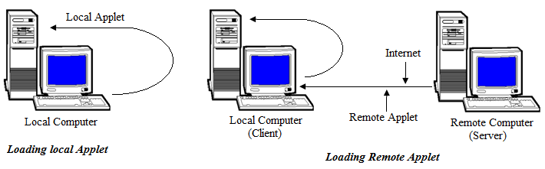
Java Applet
Applets are basically small Java programs, which can be easily transported over the network from one computer to other.
This is the reason why applets are used in Internet applications, where these applets (i.e. small Java Program), embedded in an HTML page, can be downloaded from the server and run on the client, so as to do a specific kind of job.

Slide 122
Java Applet
Applet | Application
The execution of the applet does not start from main() method, as it does not have one. | The execution of an application program start from main().
Applet cannot run on their own, i.e. they have to be embedded inside a web page to get executed. | These can run on their own, i.e. in order to get executed, they need not be embedded inside any web page.
Applet can only be executed inside a browser or appletviewer. | Applications are executed at command line.
Applets execute under strict security limitations that disallow certain operations (sandbox model security). | Application have no inherent security restriction.
Applets have their own life cycle init() → start() → paint() → stop() → destroy(). | Applications have their own life cycle. Their execution begins at main().

Slide 123
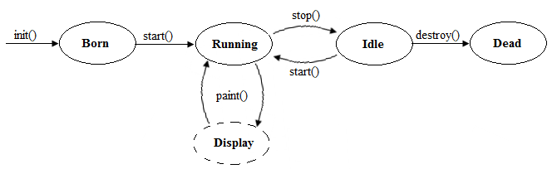
Applet Life Cycle (Applet Skeleton)

Slide 124
Passing Parameter to an Applet
We can supply user defined parameter to an applet using <PARAM> tag & each <PARAM ..> tag has a name attribute & its value attribute. Inside the applet code, the applet can refer to that parameter by name to find its value.
Example:
<PARAM NAME = text VALUE =”Java”> <PARAM NAME = font VALUE =”Courier”> <PARAM NAME = color VALUE =”Red”>

Slide 125
Working with Colors
Java supports a color in an independent fashion. The awt.Color system allows the programmer to specify any type of Color.
To set the background & foreground colors in an applet following syntaxes are used.
To set the color to an object, the setcolor() method found in the Graphics class is used. The getcolor() method helps to know present color of applet.
Syntax: | Example
setBackground(Color.new) setForeground(Color.new) | setBackground(Color.blue) setForeground(Color.red)
Syntax: | Example
Color c = new Color(int red, int green, int blue) | Color c = new Color(255,100,5)
This constructor takes three parameters that specify the color has mixture of RGB. These integer values lies between 0 – 255
Syntax: | Example
Color c = new Color(float red, float green, float blue) | Color c = new Color(0.0, 0.5, 1.0)
This constructor takes three parameters that specify the color has mixture of RGB. These float values lies between 0.0 – 1.0

Slide 126
Working with Fonts
Text can be written inside an applet using different fonts. The java.awt supports multiple types of fonts. Fonts are encapsulated in a Font class.
To select a new font you must first construct a font object that describes that font.
To Select a font setfont() method is called & to get the information about currently selected font then call getfont() method.
Syntax: Font(String Font_name, int Font_style, int Font_size);
Font_name | Specify the name of the desired font (Times New Roman, Courier, Arial, etc.)
Font_style | Specify style of font & it takes following constant (BOLD, ITALIC, PLAIN)
Font_size | Specify the size of the font (8 – 72)
Example: Font f = new Font(“courier”,Font.BOLD,20)

Slide 127
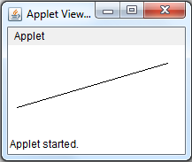

Working with Graphics
One of the most important features of Java is its ability to draw Graphics. Java’s Graphics class includes method for drawing a line, circle, ellipse, polygon etc.
Line: The simplest shape we can draw with the Graphics class is a line. To draw a line, we can use drawLine() method & it takes two pairs of coordinators.
Syntax: g.drawLine(x1,y1,x2,y2); | Example: g.drawLine(10,70,180,20);
Where x1 & y1 represents the starting point and x2 & y2 represents the final points.

Slide 128
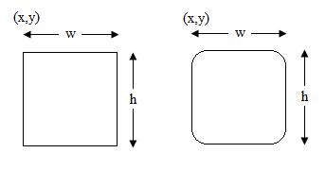
Working with Graphics
Rectangle: To draw rectangle drawRect() method is used. It takes four parameter first two parameters represents top left corner & last two parameters represent the width & the height of the rectangle.
If w=h then it becomes square.
fillRect() method is used to draw the rectangle & fill inside portion with any other color. The Rectangle with rounded edge can be drown using drawRoundRect() method.

Slide 129
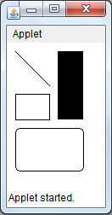
Working with Graphics
Example: | Output:
import java.applet.*; import java.awt.*; /* <Applet code="LineRect.class" width=100 height=170> </Applet> */ public class LineRect extends Applet { public void paint(Graphics g) { g.drawLine(10,10,50,50); g.drawRect(10,60,40,30); g.fillRect(60,10,30,80); g.drawRoundRect(10,100,80,50,10,10); } }

Slide 130
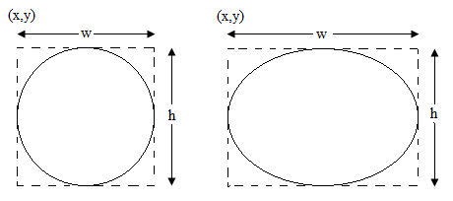
Working with Graphics
Circle & Ellipse: The graphics class doesn’t have any method for circle & ellipse. However drawOval() method can be used to draw circle & ellipse. It takes 4 parameters. The first two parameters takes top left corner & last two parameters takes width & height of the imaginary rectangle.
fillOval method us used to fill inside portion of the ellipse & circle.

Slide 131
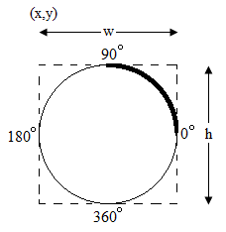
Working with Graphics
Arc: Arc is a part of oval & it takes 6 parameters. First two parameters represents top left corner. Middle two parameters represent width & height of the imaginary rectangle. Last two parameters represent the starting angle & shift the angles in degrees.
Example: drawArc(10,10,40,40,0,90)

Slide 132
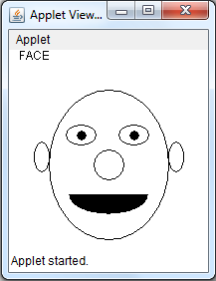
Working with Graphics
Example: | Output:
import java.applet.*; import java.awt.*; /* <Applet code="Face.class" width=200 height=200> </Applet> */ public class Face extends Applet { public void paint(Graphics g) { g.drawString("FACE",10,10); g.drawOval(40,40,120,150); g.drawOval(57,75,30,20); g.drawOval(110,75,30,20); g.fillOval(68,81,10,10); g.fillOval(121,81,10,10); g.drawOval(85,100,30,30); g.fillArc(60,125,80,40,180,180); g.drawOval(25,92,15,30); g.drawOval(160,92,15,30); } }

Slide 133
- Thank You

